Slide 1

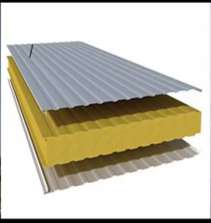
VIBRATIONAL ANALYSIS OF SANDWICH BEAM
Mechanical Vibrations Mini Project
Batch - 07
Presented by .
B. Bhaskar – 234103412
B. Durga Prasad – 234103413
Aman Patel - 234103404

Slide 2
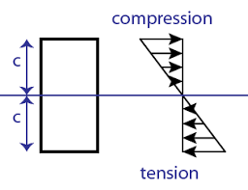
INTRODUCTION :
Outer fibres of a beam subjected to bending will carry more Bending stresses than at that of the inner fibres.
1. I-Section
2. Sandwich Beam
What is Sandwich beam ?
What are the Materials that can be used for the Core and Faces ?
Advantages of Sandwich beam ?

Slide 3
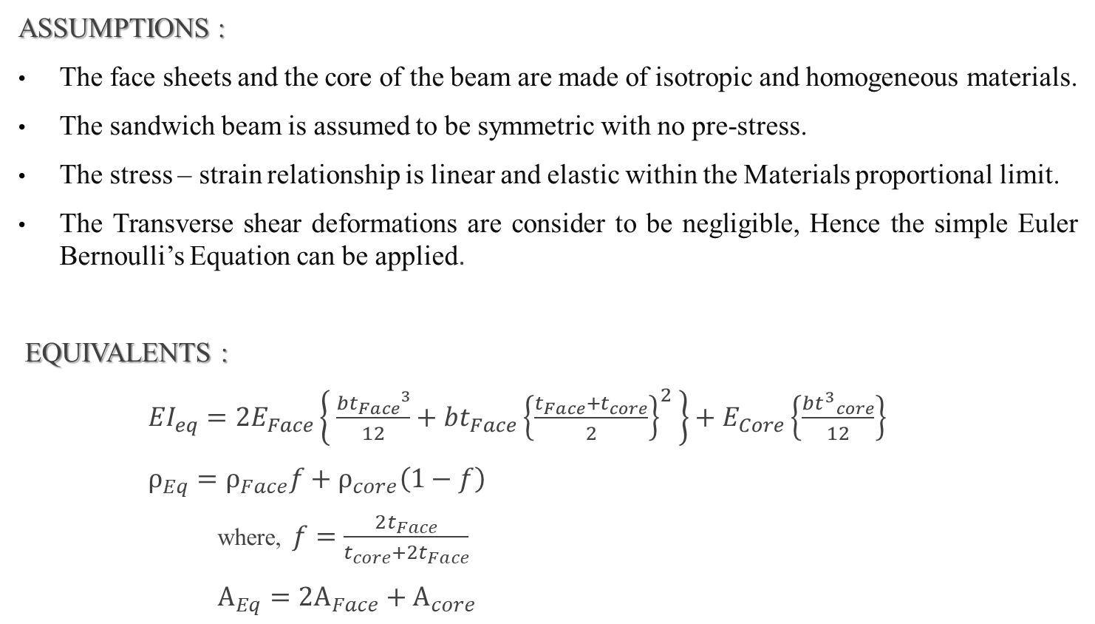
FORMULATION :
ASSUMPTIONS :
The face sheets and the core of the beam are made of isotropic and homogeneous materials.
The sandwich beam is assumed to be symmetric with no pre-stress.
The stress – strain relationship is linear and elastic within the Materials proportional limit.
The Transverse shear deformations are consider to be negligible, Hence the simple Euler Bernoulli’s Equation can be applied.
EQUIVALENTS :
${EI}_{eq}=2E_{Face}\left\{ \frac{b{t_{Face}}^{3}}{12}+b{t_{Face}{\left\{\frac{t_{Face}+t_{core}}{2}\right\}}^{2}}^{ }\right\}+E_{Core}\left\{\frac{b{t^{3}}_{core}}{12}\right\}$
$ρ_{Eq}=ρ_{Face}f+ρ_{core}\left(1−f\right)$
where, $f=\frac{2t_{Face}}{t_{core}+{2t}_{Face}}$
$A_{Eq}={2A}_{Face}+A_{core}$

Slide 4
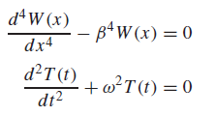

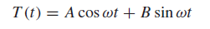
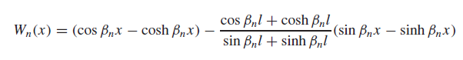

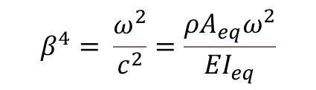

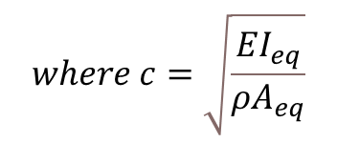
GOVERNING EQUATION :
$$\frac{∂^{2}}{∂x^{2}}\left\{ {EI}_{eq}\frac{∂^{2}w}{∂x^{2}} \right\}+ ρA_{eq}\frac{∂^{2}w}{∂t^{2}}=0$$
$$c^{2}\frac{∂^{4}w}{∂x^{4}}+\frac{∂^{2}w}{∂t^{2}}=0$$
$$where c=\sqrt{\frac{{EI}_{eq}}{{ρA}_{eq}}}$$
$$β^{4}= \frac{ω^{2}}{c^{2}}=\frac{{{ρA}_{eq}ω}^{2}}{{EI}_{eq}}$$
On Solving using the above Governing equations,
For a beam Fixed at one end and free at other end the equation becomes,

Slide 5
MATLAB :
clc;
clear;
syms bL
eqn=cos(bL)*cosh(bL)==-1;
bLi=[];
for i=1:1:13
j=i+1;
bl=vpasolve(eqn,bL,[i j]);
bl=double(bl);
bLi=[bLi,bl];
end
bLi
I_Face=((b*t_Face^3)/12+b*t_Face*((t_Core+t_Face)/2)^2)*2;
I_Core=b*t_Core^3/12;
EI_eq=E_Core*I_Core+E_Face*I_Face;
disp(EI_eq);
A_Face=b*t_Face*2;
A_Core=b*t_Core;
f=2*t_Face/(t_Core+2*t_Face);
rho_Face=7850;
rho_Core=80;
rho_eq_A_eq =(rho_Face*f*A_Face+rho_Core*(1-f)*A_Core);
%Natural Frequency in rad/sec
wn=(bLi).^2*sqrt((EI_eq)/(rho_eq_A_eq*L^4));
fn=wn/(2*pi); %in Hertz
wn
fn
% Mode shapes
% Base state
dx=0.01;
% Beam Properties
L=0.18; % Length of sandwich Beam
E_Face=210e09; % Young's Modulus of Face
E_Core=56e06; % Young's Modulus of Core
b=0.025; % Breadth of the beam
t_Face=0.003; % Thickness of Face Material
t_Core=0.010; % Thickness of Core Material

Slide 6
x=0:dx:L;
W0=zeros(1,(length(x)));
plot(x,W0,'k--');
hold on
%Fourth Mode
bL=bLi(4);
W4=ModeShape (bL,dx,L);
plot(x,W4,'m','DisplayName','Mode-Shape 4');
hold on
legend('show','location','southwest');
%First Mode
bL=bLi(1);
W1=ModeShape (bL,dx,L);
plot(x,W1,'b','DisplayName','Mode-Shape 1');
hold on
%Second Mode
bL=bLi(2);
W2=ModeShape (bL,dx,L);
plot(x,W2,'r','DisplayName','Mode-Shape 2');
hold on
%Third Mode
bL=bLi(3);
W3=ModeShape (bL,dx,L);
plot(x,W3,'g','DisplayName','Mode-Shape 3');
hold on
% Defining the Function for an Equation
function W=ModeShape (bL,dx,L)
b=bL/L;
C=cos(bL); S=sin(bL); Ch=cosh(bL); Sh=sinh(bL);
a=(C+Ch)/(S+Sh);
x=0:dx:L;
C=cos(b*x); S=sin(b*x); Ch=cosh(b*x); Sh=sinh(b*x);
W=(C-Ch)-a*(S-Sh);
end

Slide 7
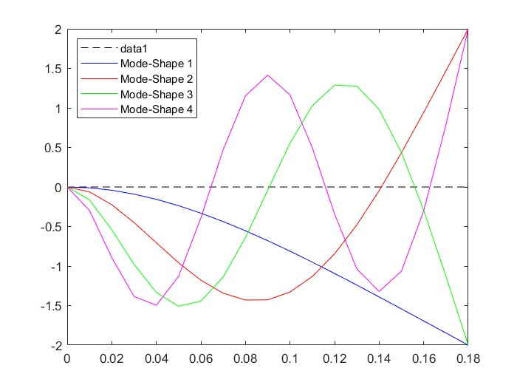
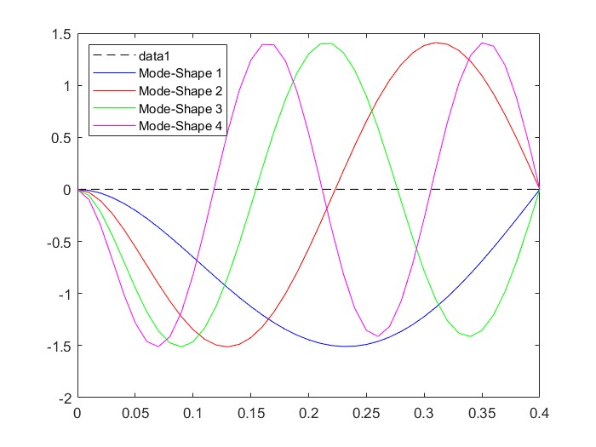
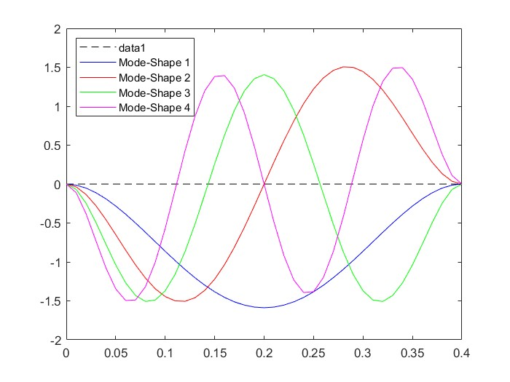
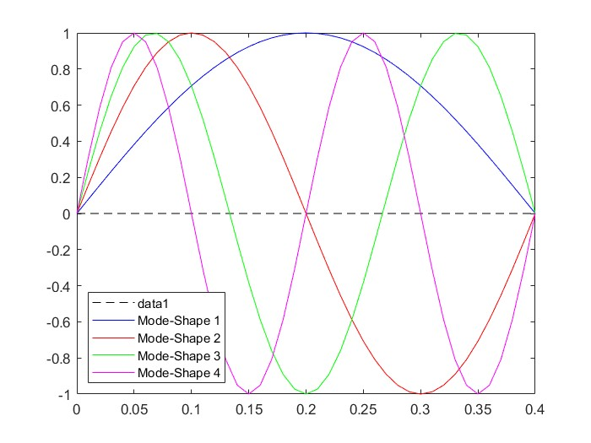
Fixed-Free
Fixed-Hinged
Fixed-Fixed
Hinged-Hinged

Slide 8
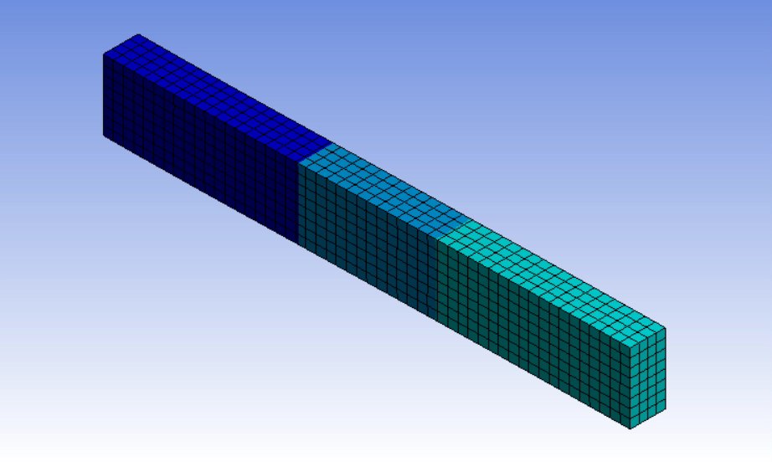
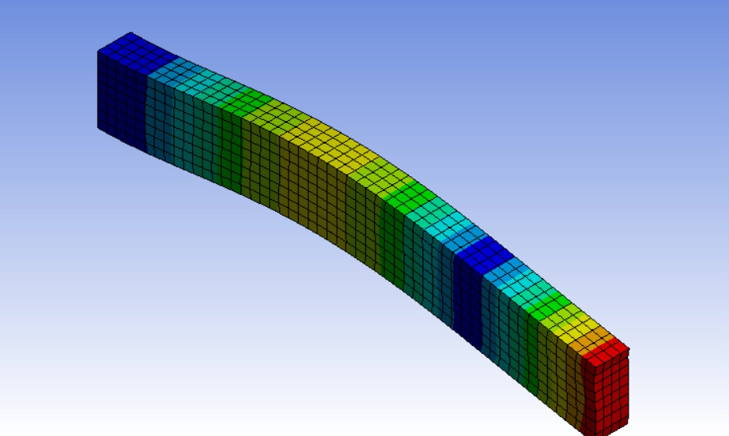
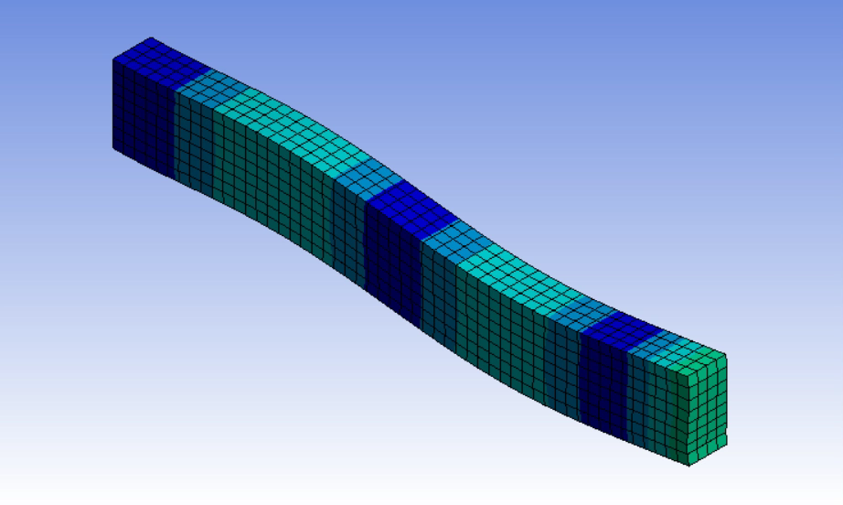
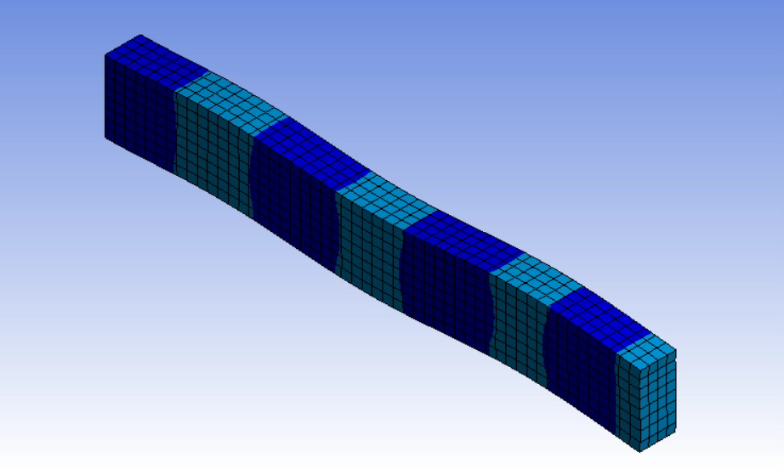

Slide 9
RESULTS:
Natural frequencies (Hz) for different beams
Mode | Fixed-Free | Fixed-Hinged | Fixed-Fixed | Hinged-Hinged
1 | 545 | 2389 | 3466 | 1529
2 | 3414 | 7740 | 9554 | 6116
3 | 9558 | 16150 | 18730 | 13761
4 | 18730 | 27617 | 30962 | 24464

Slide 10
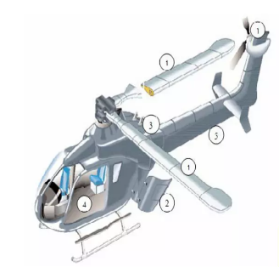

APPLICATIONS :
Aerospace Application – Sandwich applications in aircraft or Helicopters (Jaguar, Light compact Aircraft, Advanced light Helicopter) includes wings, ailerons , floor panels and storage and pressure tanks
Building Constructions – Finds Applications where light weight and Insulation type of construction is required.
Damped Structures – An Increase in number of vibration problems can be controlled by using a symmetric sandwich panel with usage of sandwich beam .

Slide 11
CONCLUSION :
By studying the above comparsion we can predict the behaviour of composite sandwich beams made of Structural steel and PVC foam and with this conclusion sandwich beams can be used to appropriate application.
While our Analysis provide valuable insights we acknowledge certain limitations such as isotropic material properties and linear behaviour were assumed that will affect the result accuracy so future study could explore more advanced models to capture additional complexities.

Slide 12
REFERENCES :
Elnady, Abdelrady. (2015) Free Vibration Analysis of Sandwich Beam Structure Using Finite Element Approach. IOSR Journal of Mechanical and Civil Engineering (IOSR-JMCE). 12. PP 34-42. 10.9790/1684-12613442.
Yash Gupta, Varghese Paul V, Ashish Jacob and Akash Mohanty (2020) Effect of the core thickness on the flexural behaviour of polymer foam sandwich structures. IOP Publishings. DOI 10.1088/2633-1357/abb0f5.
Syed Mudassir, Dr. D.V. Ravi Shankar, Dr. M. Manzoor Hussain (2016) Flexural Behavior of Sandwich Composite Panels Under 4-Point Loading. International Journal of Materials Science ISSN 0973-4589 Volume 11, Number 1,pp. 47-55.
Singiresu S. Rao (2007), Vibration of Continuous systems, Wiley Publications

Slide 13
THANK YOU

